Slide 1

Heredity and Evolution
Origin Of Life On Earth

Slide 2


Transfer of characters from one generation to another
So, the ideas of heredity
and genetics are essential for understanding evolution

Slide 3
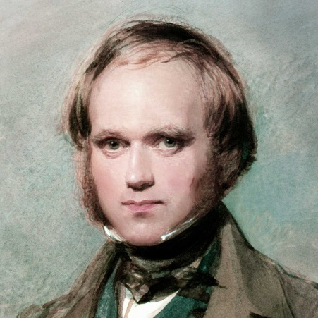
The first idea of evolution of species by natural selection in the nineteenth century was given by
Charles Robert Darwin

Slide 4
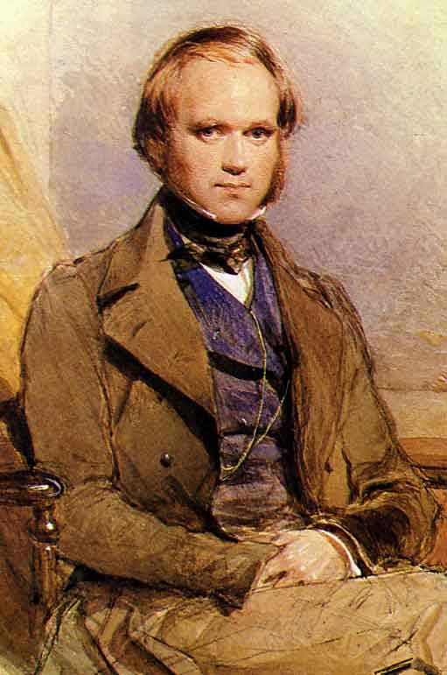
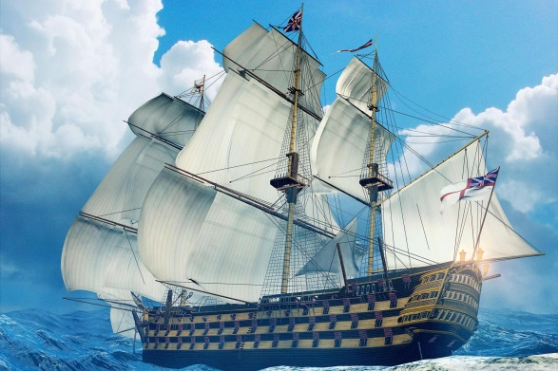
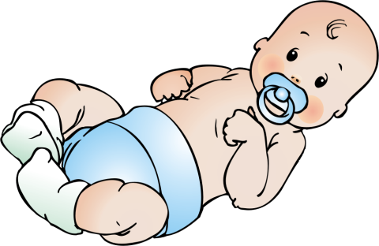
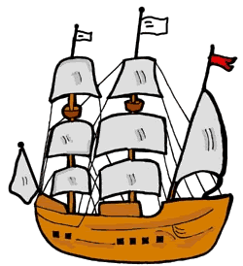
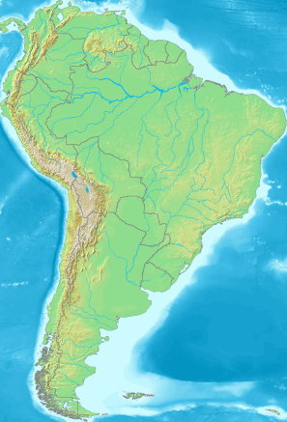
Charles Robert Darwin (1809–1882)
Charles Robert Darwin was born on 12 feb 1809 in Shrewsbury, England, the son of Robert Waring Darwin and Susannah.
12 feb 1809
The 5 -year
voyage
When he was 22 years old.
He set out on a voyage on a ship.
Took him to South America and the islands off its coast.

Slide 5

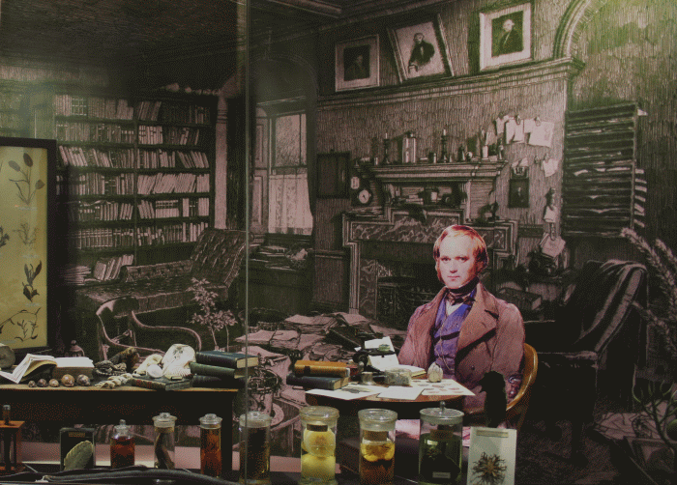
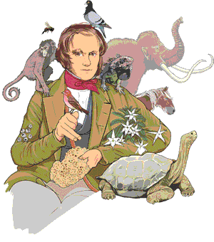
Charles Robert Darwin (1809–1882)
After he got back to England.
He conducted studies during this voyage at the variety of life on earth.
Conducted various experiments that led him to formulate his hypothesis that evolution took place due to natural selection.

Slide 6
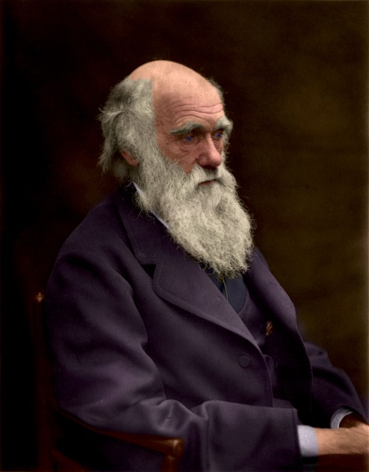
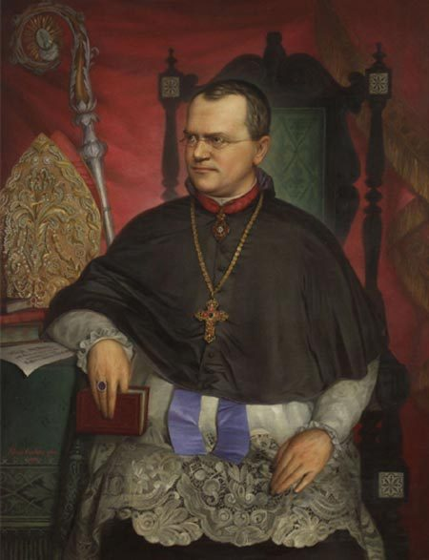
Charles Robert Darwin (1809–1882)
But he did not know the mechanism behind the changes arose in the species.
But these two gentlemen
did not know of each other or their work!
These mechanisms were studied by Mendel during the same time.

Slide 7
Darwin’s theory of evolution and Mendel Experiment give mechanism for the inheritance of traits from one generation to the next.

Slide 8
But neither tells us about how life originated on earth

Slide 9

Lets discuss how life originated on earth.

Slide 10
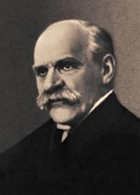
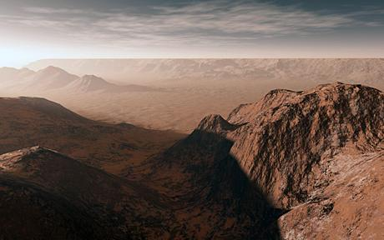
Origin of life on earth
The first theory was given by
J.B.S. Haldane
He suggested in 1929 that life must have developed from the simple inorganic molecules (Carbon, Hydrogen, Oxygen and Nitrogen)which were present on earth soon after it was formed.
A British scientist
(who became a citizen of India later)

Slide 11
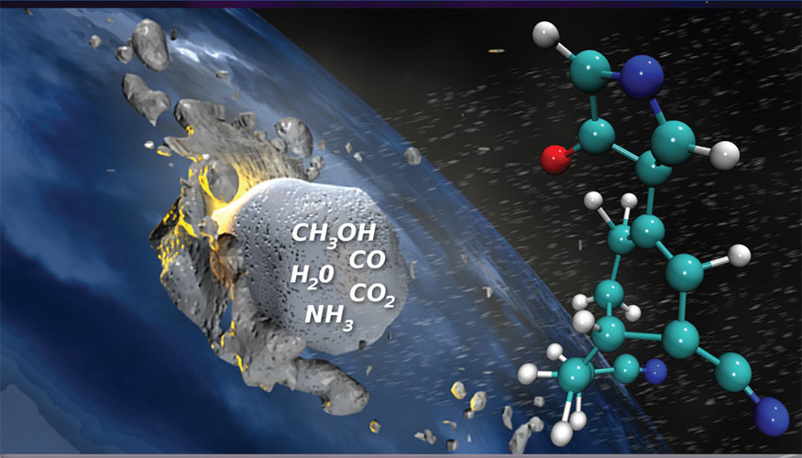
Origin of life on earth
The first theory was given by
J.B.S. Haldane
He speculated that these simple inorganic molecules gave rise to more complex organic molecule (Proteins, Carbohydrates, DNA, RNA) that were necessary for life.
The first primitive organisms would arise from further chemical synthesis.

Slide 12
But the question was how did these organic molecules arise???

Slide 13

An answer was suggested by the experiment
conducted by Stanley L. Miller and Harold C. Urey in 1953.

Slide 14
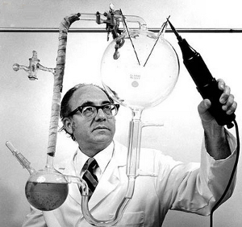

Miller and Urey Experiment
Ammonia, methane and hydrogen sulphide
They assembled an atmosphere similar to that thought to exist on early earth (this had molecules like ammonia, methane and hydrogen sulphide, but no oxygen).
So, with this experiment Miller and Urey suggested the answer of the origin of life on earth
This was maintained at a temperature just below 100°C.
Sparks were passed through the
mixture of gases to simulate lightning.
The mixture is condensed using condenser.
Condenser
At the end of a week, 15% of the carbon (from methane) had been converted to simple compounds of carbon including amino acids which make up protein molecules.

Slide 15
Thank You

